Slide 1
Continuous Scatter Plot
Paper by: Sven Bachthaler and Daniel Weiskopf
Presented by: Ayan Biswas

Slide 2
Scatter Plots
Powerful for data visualization
Notion of continuous scatter plots
General mathematical model
Common case computation model

Slide 3
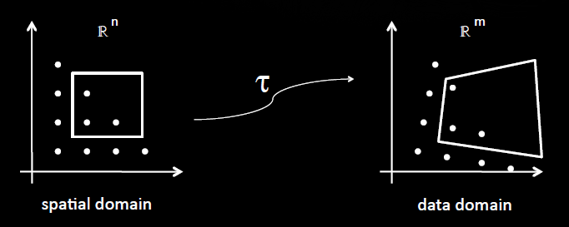
Mathematical Model
Input field on n-dimensional domain (spatial domain)
m-dimensional domain of the scatterplot (data domain)
Input field is represented by τ

Slide 4
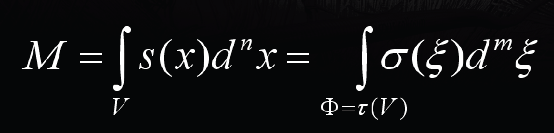
Mathematical Model contd.
Density distribution in Spatial Domain S
Density distribution in Data Domain σ
Mass conservation

Slide 5
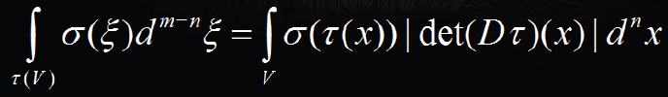

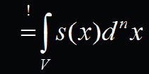
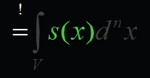

Mathematical Model contd.
Case m=n
Assuming τ is diffeomorphic
We get

Slide 6

Mathematical Model contd.
When det(Dτ)=0
Piecewise constant
τ (x)=∑_{i}τ_{i}χ_{i} (x)
_{where}
_{Then we get}

Slide 7
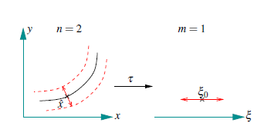
When m<n
Dimensionality problem
Divide the volume V into
Inverse image of ξ₀ i.e. isocontour
Perpendicular space around this isocontour

Slide 8
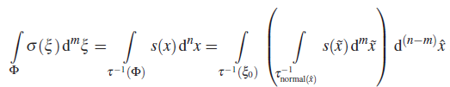

Case :m<n contd.
Then we get
Finally we arrive at

Slide 9
Algorithm
• The algorithm step-by-step:
1. Classify a tetrahedron based on its silhouette in
the data domain.
2. Attach data values as 2D geometric coordinates.
3. Determine the volume measure |Vol(Dτ)(x)|.
4. Compute the Euclidean distance between front-face
and back-face of the tetrahedron at the vertices. Divide
by the volume measure and attach to the vertices.
5. Render triangles with additive blending

Slide 10
My Steps
Collected the input dataset. This data set is 3-D(spatial) X 1-D(scalar).
Read the input dataset into an array.
Calculate the gradient of the input scalar data and store in the array. Now we have 3-D(spatial) X 2-D(scalar) data set as the input.
The input mesh is broken into cubes.
Each cube is decomposed into six tetrahedrons. (No cracking problem)
Now each tetrahedron is projected into data space and is further divided into triangles.
Each triangle has 3 points each of which has two scalar values. I calculate the IsoSurfaces for the triangle vertices' scalar values. Inside the tetrahedron, the Isosurface is a triangle. This Isosurface algorithm is written by me.

Slide 11
My Steps..
For each vertex, we have two triangles for the two scalar values. Now I calculate the intersection of the two triangles. This is a straight line. The length of the line is calculated and stored.
Volume measure is calculated as the cross product of the gradient of the two scalar values.
10. Divide the line length by volume measure and use this value to look up from a predefined color map and assign the color to the vertex.
11. Using OpenGL, I repeat these steps for all the triangles and their vertices and draw on screen with additive blending.

Slide 12
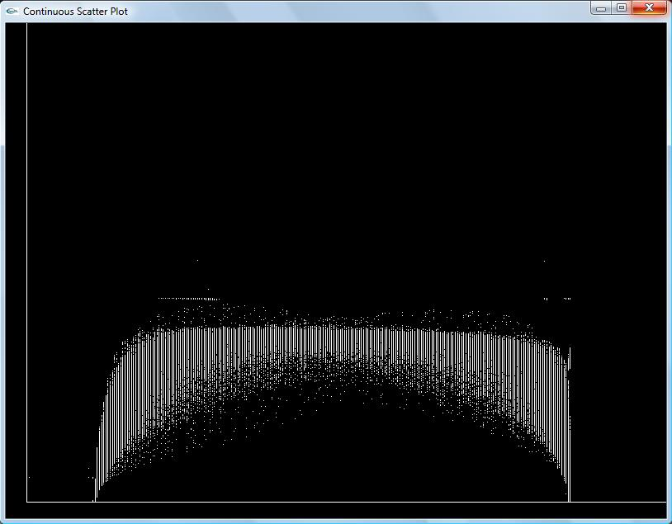
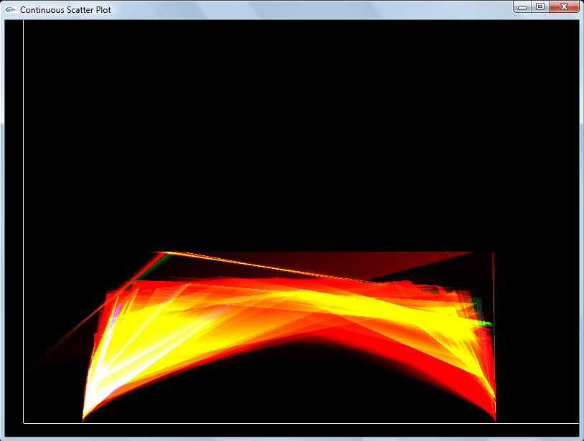
Results
Shockwave.raw (64x64x512)
Discrete Continuous

Slide 13
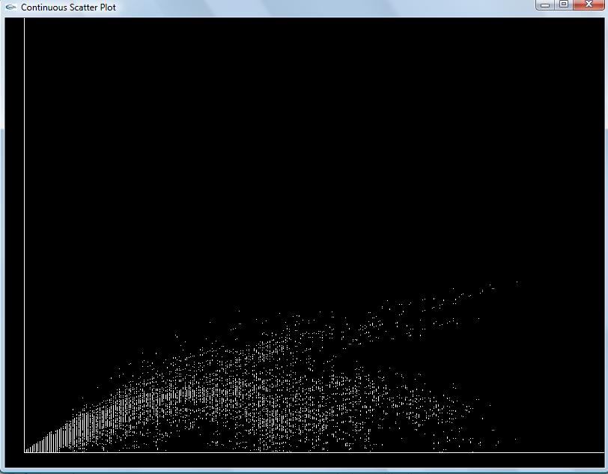
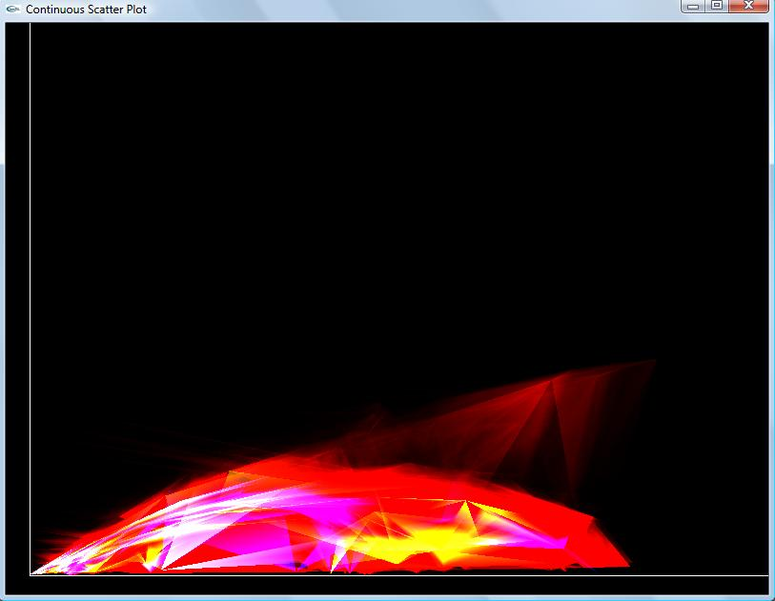
Results
Silicium.raw (34x34x98)
Discrete Continuous

Slide 14
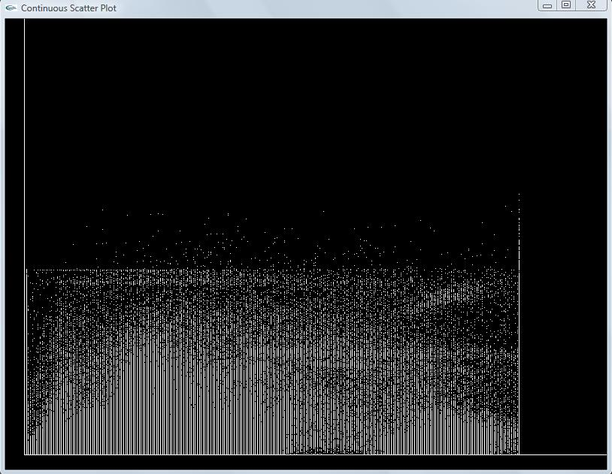
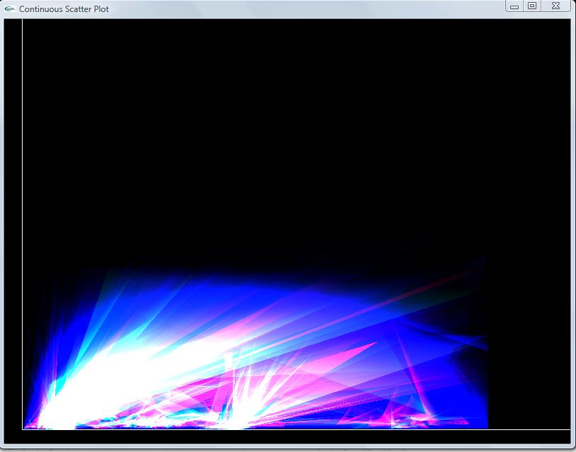
More Results
Teddybear.raw (62x128x128)
Discrete Continuous

Slide 15
Conclusion
Discrete scatterplot Continuous scatterplot
parameter dependent parameter free
resolution dependent resolution independency
arbitrary data types continuous data sets only
fast and simple precomputation takes some
time

Slide 16
Thanks..!!
Questions?

Slide 17
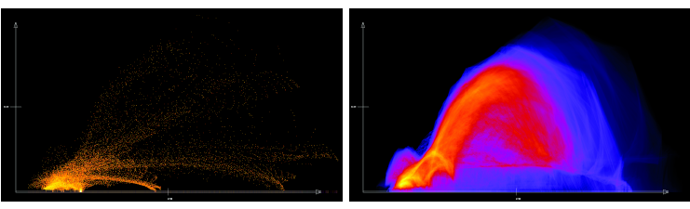
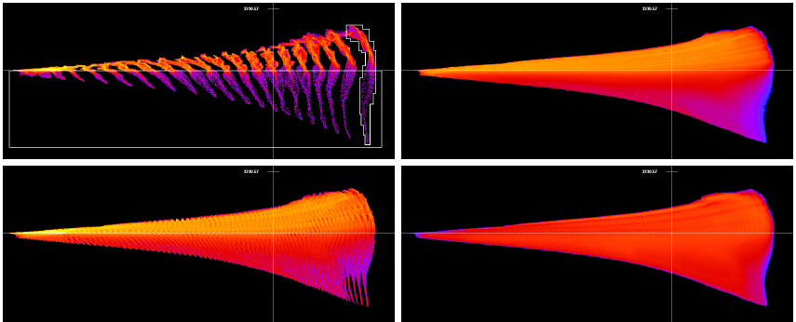
Author’s Results

